Slide 1
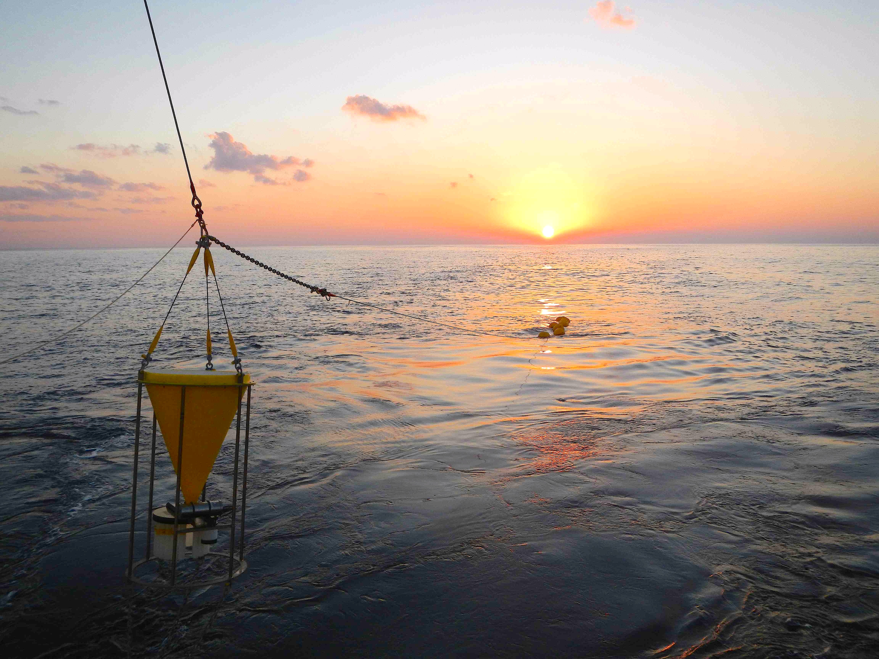
OceanSITES2016: 11th Steering committee and 8th Data Management Team meeting
National Oceanography Centre, Southampton, UK 25 – 29 Mar 2016
Detection of Fukushima-derived particulate radio-cesium in the deep of the Western Pacific
JAMSTEC
Makio Honda
Notes:
My talk is about “Detection of Fukushima-derived particulate radiocesium in the deep of the Western Pacific by using sediment trap”.
This topic is not bland new or fresh. However I decided to introduce this topic because this is a good example to show how important time-series observation or Eurelian observation with mooring system is.

Slide 2
Fukushima Dai-ichi Nuclear Power Plant Accident
11 Mar. 2011
Notes:
On 11 March 2011, the 2011 Tohoku-Oki Earthquake of magnitude 9.0 occurred off Miyagi Prefecture, Japan. This earthquake and the tsunami it generated seriously damaged the Fukushima Daiichi Nuclear Power Plant (FNPP1). As a result of the loss of power and the associated malfunction of the cooling system, large quantities of artificial radionuclides were emitted from FNPP1 by hydrogen explosions, venting, and intentional and accidental discharge of contaminated water.

Slide 3
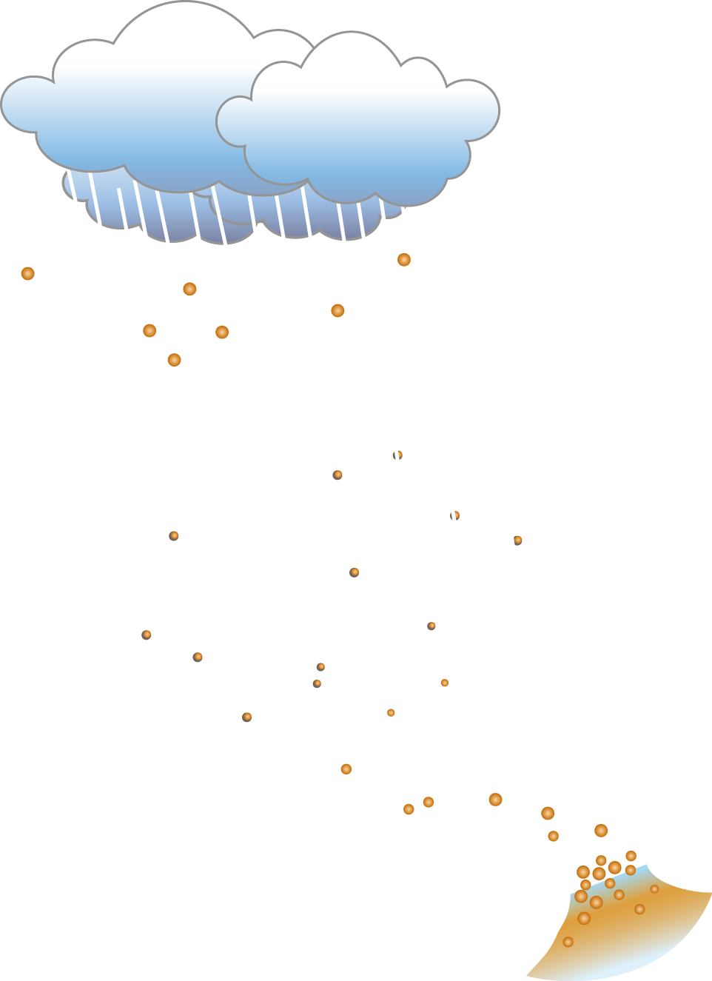
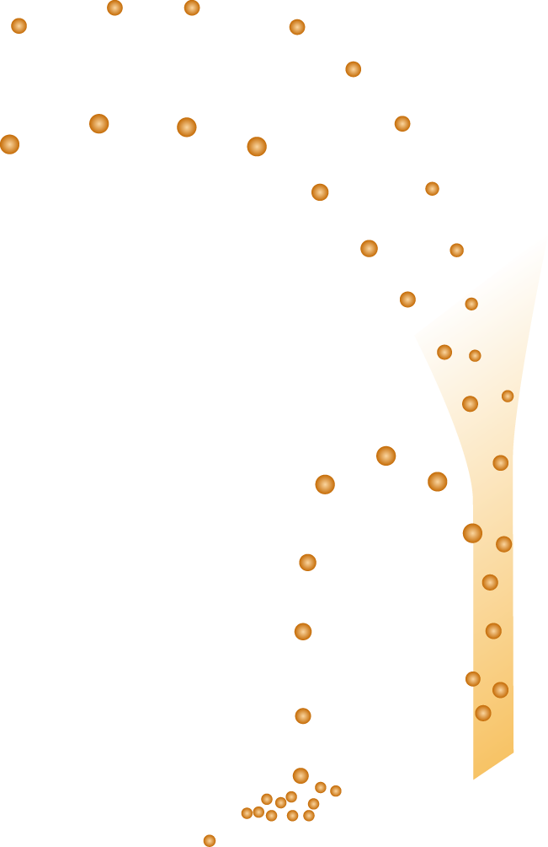
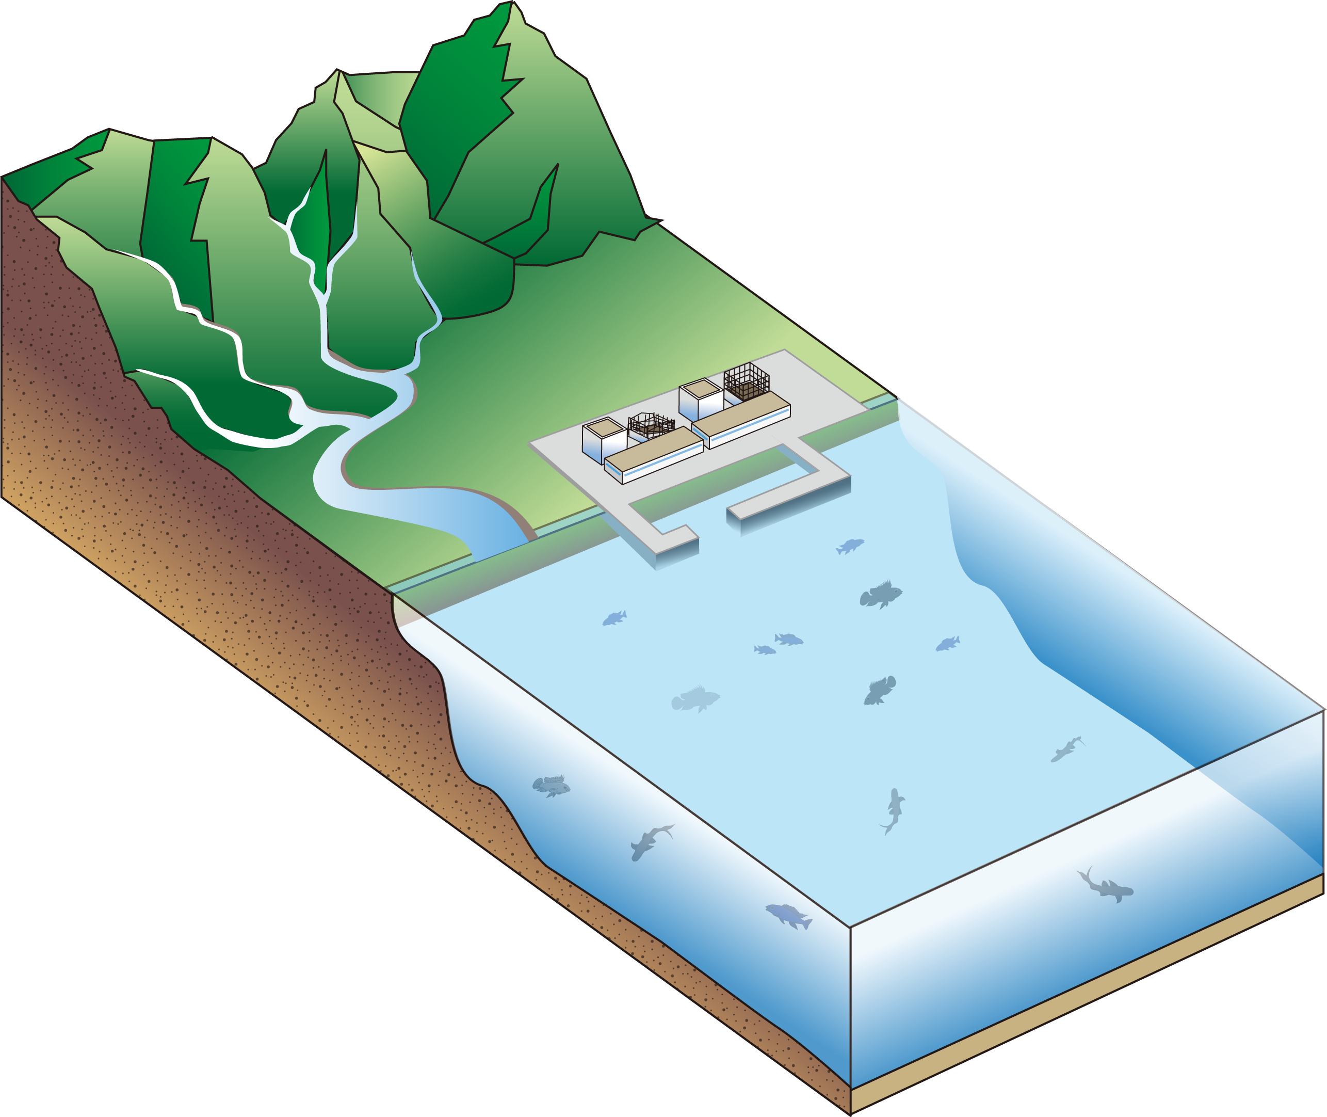
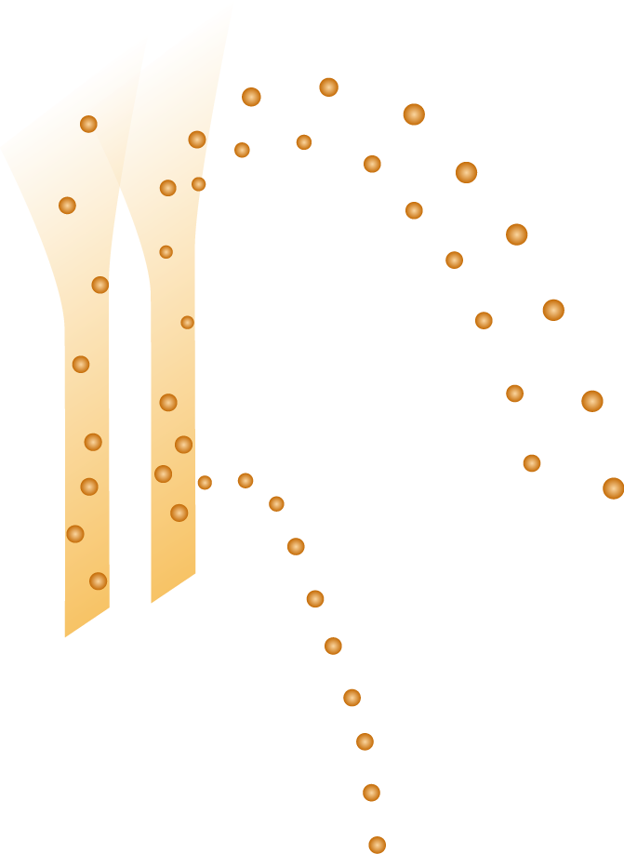
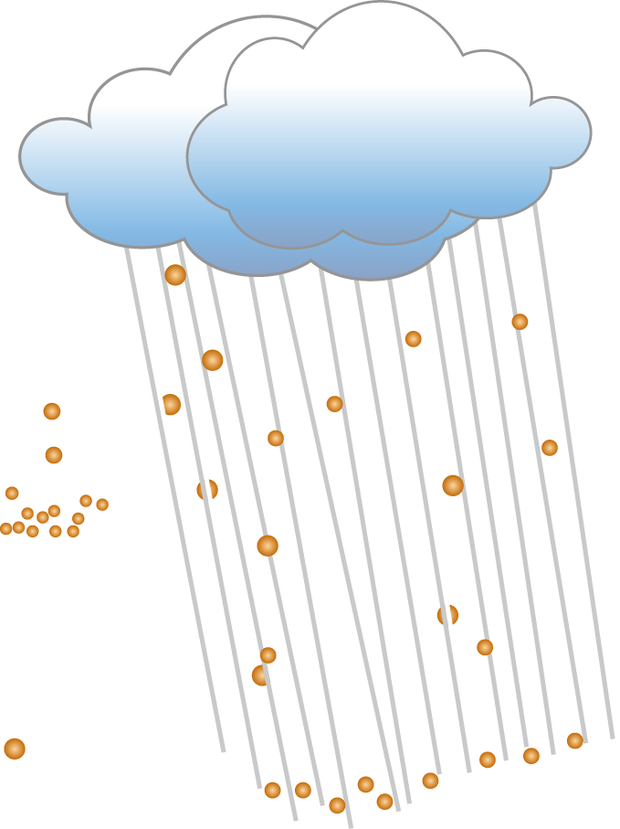
Supply of Radiocesium to the Ocean
To Atmosphere
15-20 PBq
To Atmosphere
15-20 PBq
Eolian input
12-15 PBq
Eolian input
12-15 PBq
To Land
3-3.6 PBq
To Land
3-3.6 PBq
Direct Discharge
3.5±0.7 PBq
Direct Discharge
3.5±0.7 PBq
(Aoyama et al. 2015)
Notes:
Artificial radiocesium, which is major sub-product, was emitted to the environment from Fukushima Daiichi Nuclear Power Plant. Although the total amount of emission is estimated to be about one fifth (1/5) of that from the Chernobyl nuclear power plant accident occurred today of 30 years before, radiocesium of more than 80% was transported to the ocean.

Slide 4
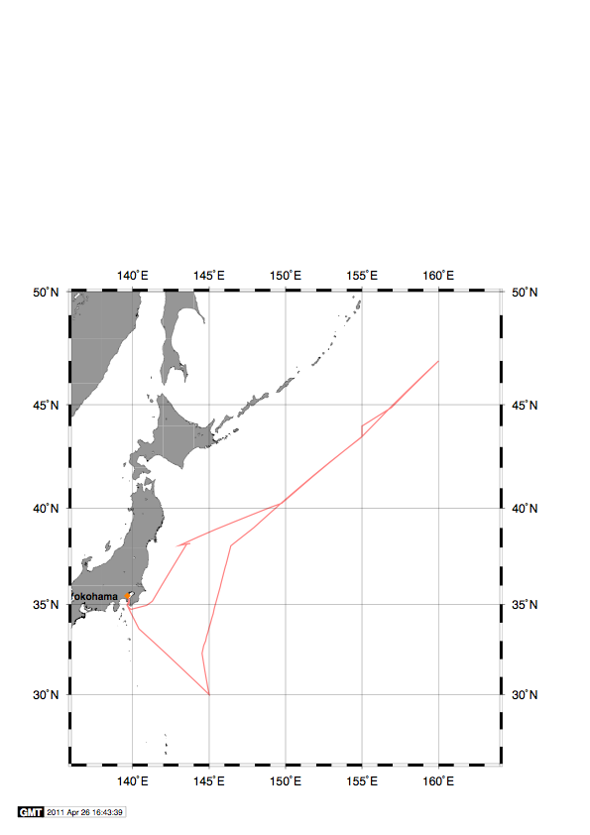
Time-series stations K2 and S1
K2
47N, 160E
5200m
(Nov. 2010~)
500m
~ 2,000 km
FNPP1
~ 900 km
5000m
S1
30N, 145E
5700m
(Nov. 2010 ~)
Notes:
At the time of the FNPP1 accident, time-series sediment traps had already been deployed at our time-series stations K2 and S1 about 2000 km and 1000 km away from the FNPP1, respectively.. We successfully collected settling particles before and after the accident.

Slide 5
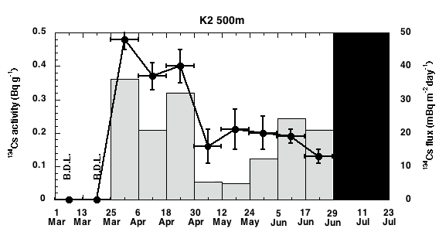
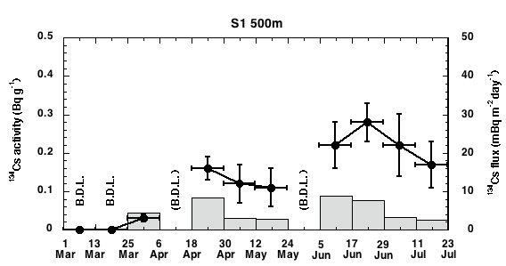
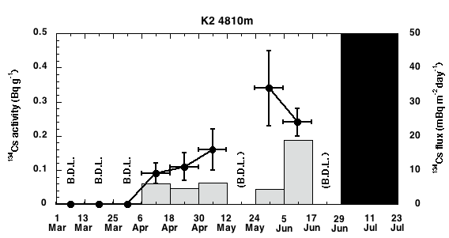
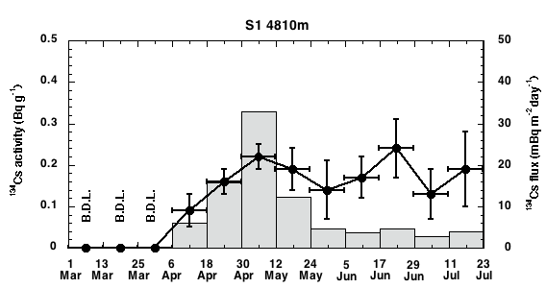
¹³⁴Cs Flux and Concentration at K2 and S1
~ 450 Bq/m²
K2 500m
~ 540 Bq/m²
S1 500m
(a)
(c)
No sample
K2 5000 m
S1 5000 m
(b)
(d)
No sample
(Honda et al., BG 10, 3525-3534.2013)
Notes:
These figure show that concentrations (line graphs) and flux (bar graphs) of 134Cs at 500 m (upper) and 5000 m (lower) of K2 (left) and S1 (right) after March 1 2011.
It is notable that ,at 500 m of both stations, the ¹³⁴Cs was detected, for the first time, in settling particles collected between 25 March and 6 April 2011.
In addition, ,at 5000m, ¹³⁴Cs was initially detected in settling particles collected during the next sampling interval, between 6 and 18 April, 12 days after it was first detected at 500 m.
Thus Fukushima-derived radiocesium arrived at deep-sea of the western North Pacific only after one month.

Slide 6
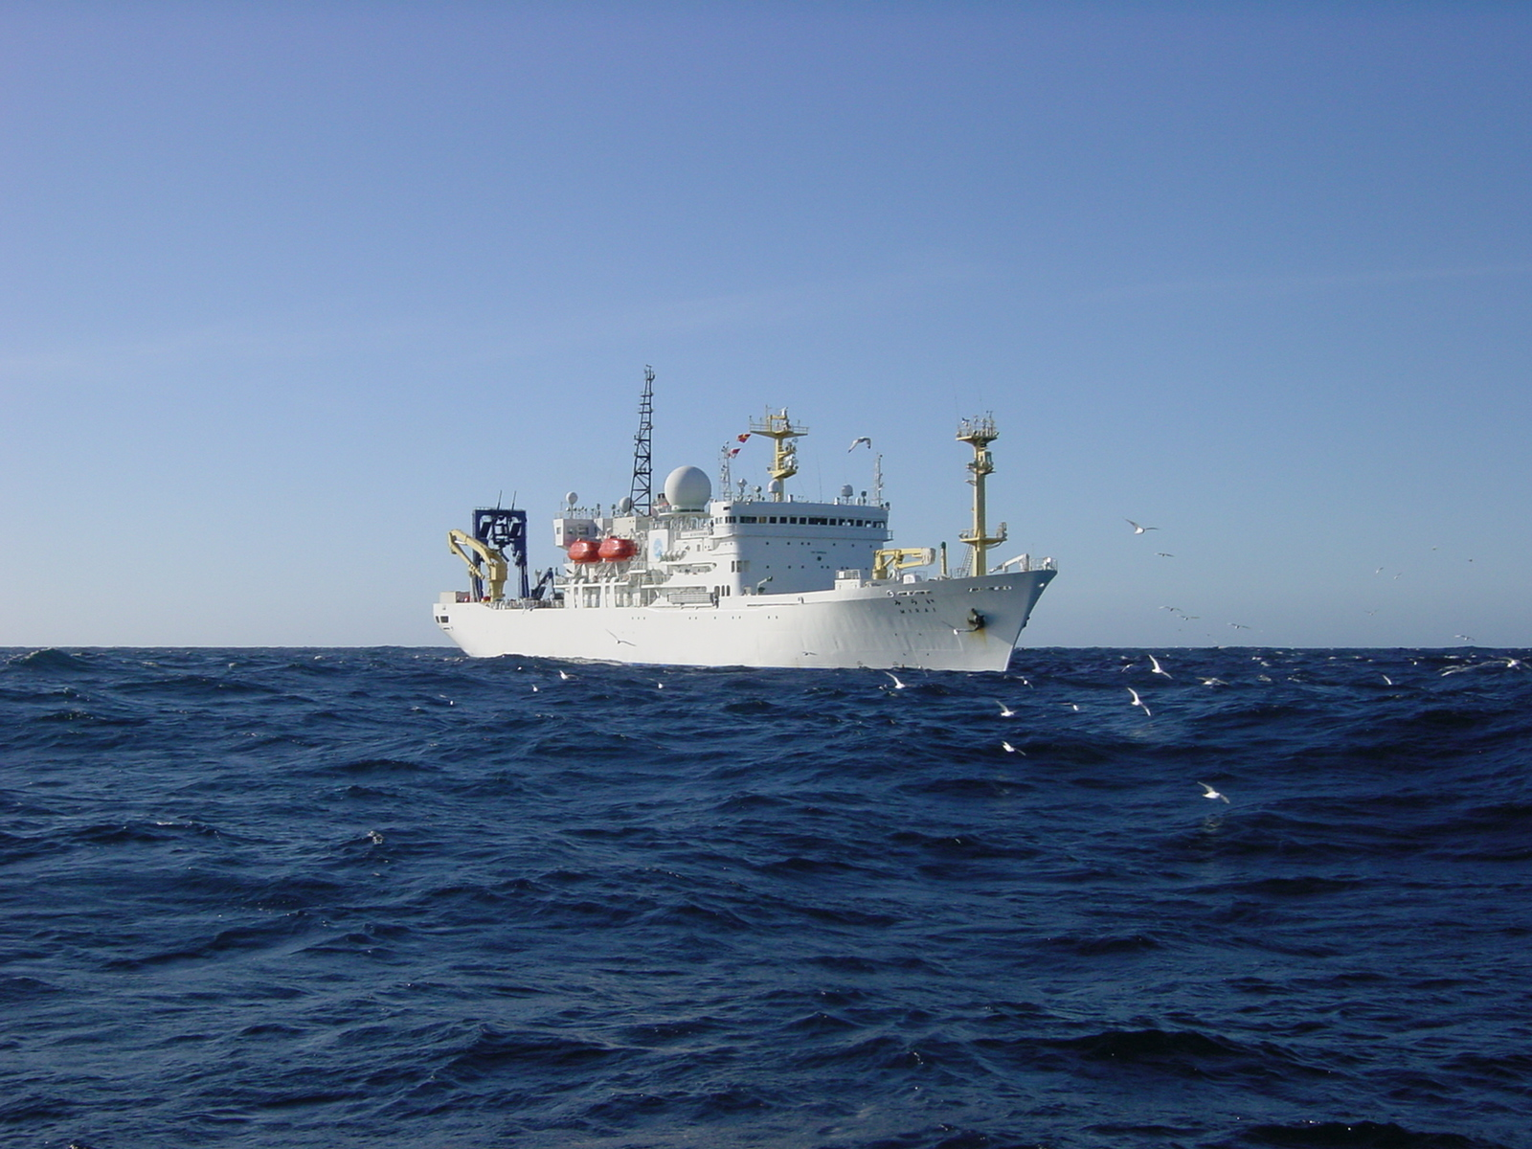
Lesson learned from Fukushima accident
Settling velocity
(0-500m) 30 ~ 50 m/day
(500m-4810m) > 180 m/day
¹³⁷Cs Flux
2 ~ 3 Bq/m²/yr.
> 99.5%: dissolved, <0.5%: particulate
Removal rate (Residence time)
~ 0.5 %/yr (~ 200 years)
Notes:
Lesson learned from Fukushima accident is
sinking velocities between 0 m and 500 m and 500 m and 5000m were estimated to be approximately 30 m day⁻¹ and higher than 180 m day⁻¹, respectively.
¹³⁷Cs Flux
2 ~ 3 Bq/m²/yr
Removal rate (Residence time)
~ 0.5 %/yr (~ 200 years)

Slide 7
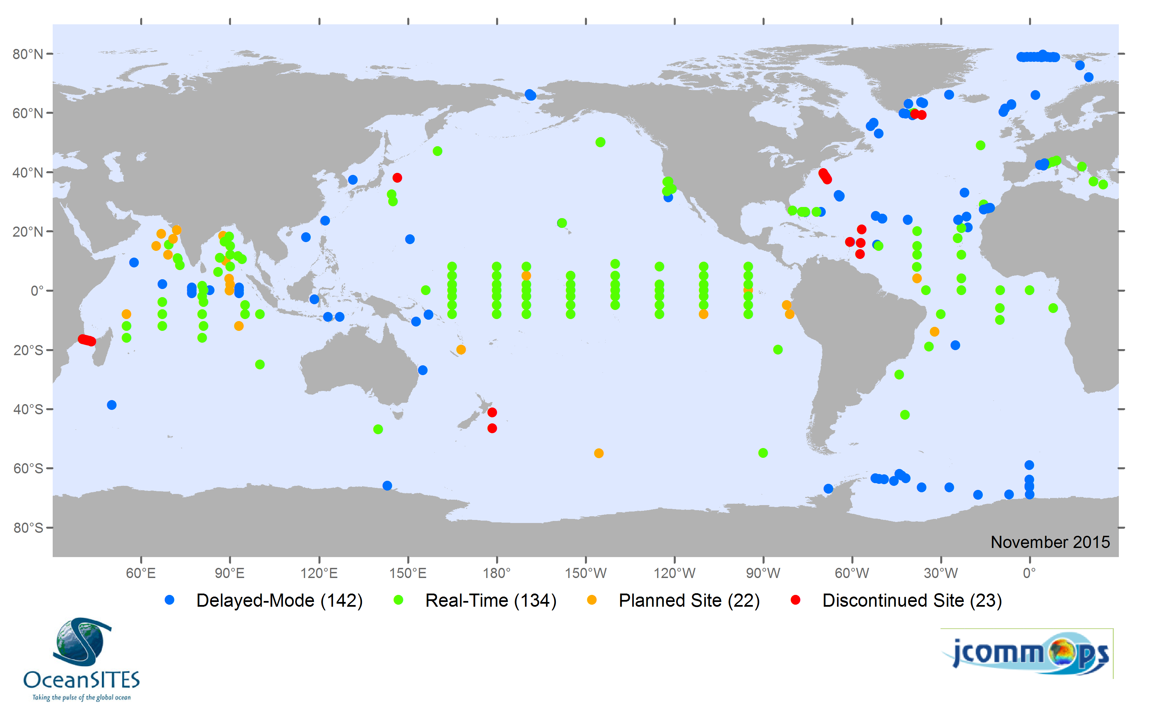
Update of K2 and S1
K2
S1

Slide 8
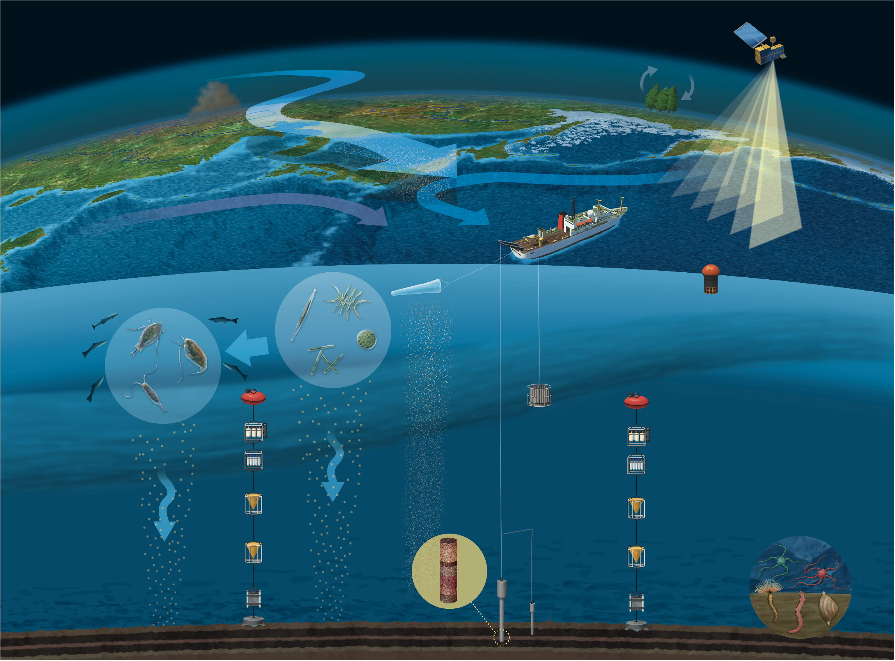
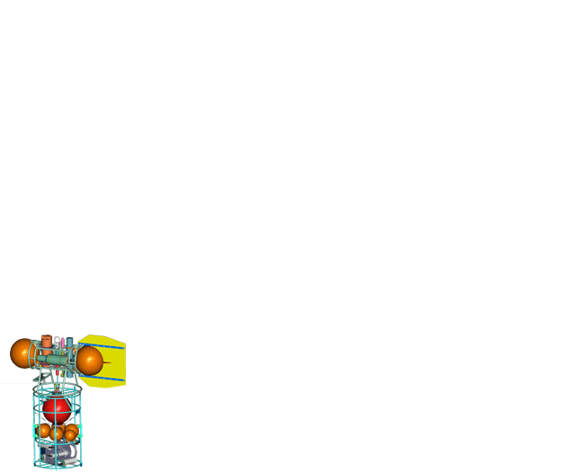
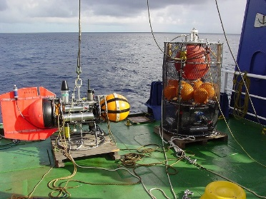
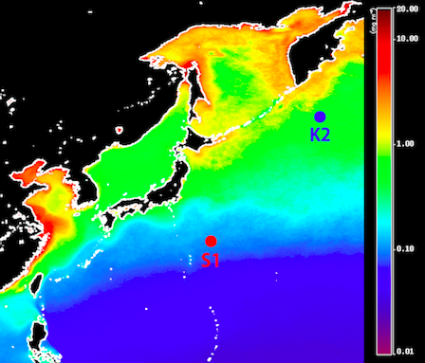
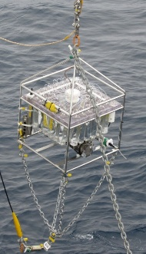
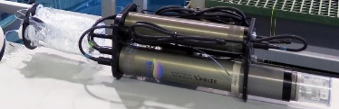
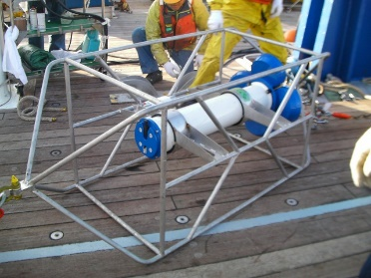
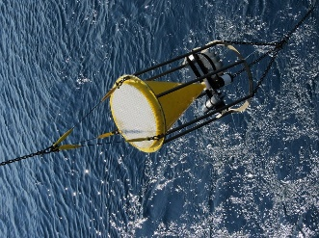
K2
(I: 2001-2015, II: 2015-)
BGC Profiler (POPPS)
（upper 150m)
Water sampler (RAS)
200, 300m
pH sensor
ADCP 400m
Sediment trap
（500, 4800m）
CTD (microCAT） 5000m

Slide 9
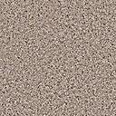
S1 (2010 - 2014) ⇨ Station KEO (2014 - )
“Missing source of nutrients”
KEO
(32.4N/144.4E)
(32.4N/144.4E)
(30.0N/145E)
(30.0N/145E)
Sediment trap
(〜5000 m)
Notes:
亜熱帯海域の時系列観測点としてKEOを選定した。ここにはNOAA-PMELの表層ブイが設置してあり、時系列の海上気象データ（風速、気圧、日射量、雨量）、海洋物理データ（水温、塩分、流向流速）の利用が可能である。

Slide 10
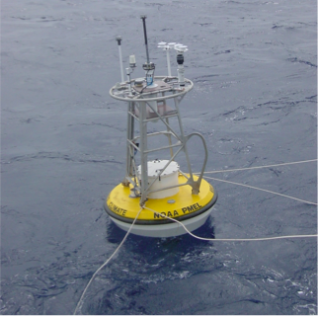
Station KEO (NOAA PMEL surface buoy)
KEO
(32.4N/144.4E)
(30.0N/145E)
Notes:
亜熱帯海域の時系列観測点としてKEOを選定した。ここにはNOAA-PMELの表層ブイが設置してあり、時系列の海上気象データ（風速、気圧、日射量、雨量）、海洋物理データ（水温、塩分、流向流速）の利用が可能である。

Slide 11
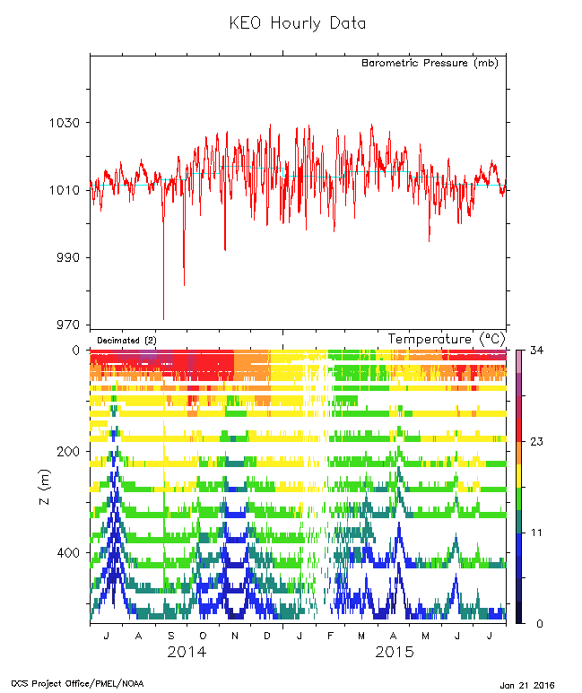
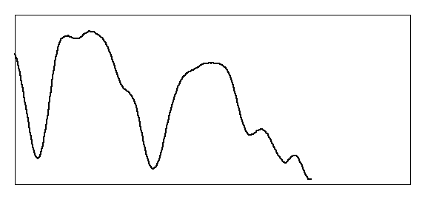
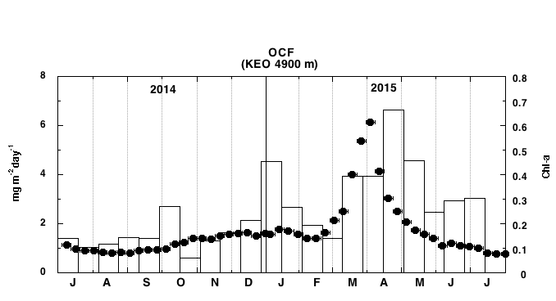
Coupling of Meteorological / Physical-Chemical Oceanography: Synergy effect
NOAA-KEO buoy data
#14
FENGSHEN
#20
NURI
#17
KAMMURI
SSHA
JAMSTE-ST data
2014
2015
Notes:
ここで2014年7月〜2015年7月の気圧、水温鉛直プロファイル、全粒子束を比較した。
当初、2014年10月に見られた全粒子束の増加は2014年9月の台風による湧昇が表層へ栄養塩を供給したため低緯度生物生産が増加したためと推定したが、観測期間中には台風とは無関係の湧昇・もしくは鉛直混合が見られた：例えば2014年7月、2014／2015冬季。どの湧昇・混合が全粒子束を増加させたのかは他のデータをあわせて詳細な議論が必要である。

Slide 12
JAMSTEC OceanSITES related mooring system
K2
KEO
TRITON 0N156E
TRITON 5S95E

